Slide 1

Music & Mental Health Survey
Presented by: Navid Saleh Sadik
Student ID: 200544271
Date: 04/04/2023

Slide 2



Agenda
Introduction to the Dataset
Research Questions
Charts and Graphs
Further discussion
Conclusion / Q/A

Slide 3




Introduction Music and Mental Health Survey Results
Source: Kaggle
Fields: Age, Depression, Anxiety, Primary streaming service, Favorite genre, Music effects
Cleaning and coding data for better analysis

Slide 4

Research Questions
What are the Top 10 Music genres among the participants?
What are the most used Music Streaming services among different age groups?
Does Music have any impact on Mental health?
(Correlation between hours listened per day and Depression and Anxiety levels)

Slide 5
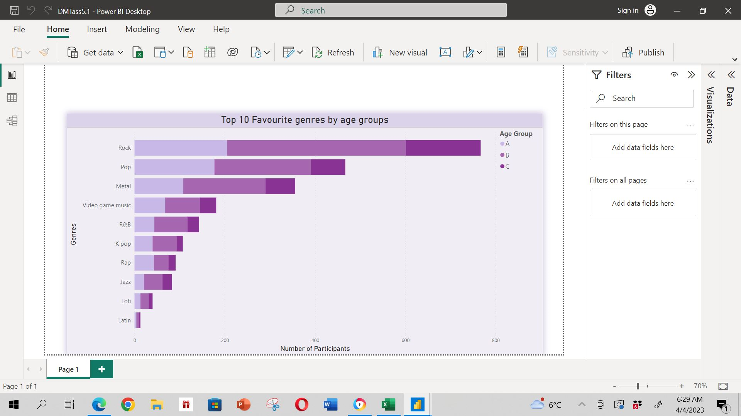
Top 10 Favourite Genres by Age group

Slide 6
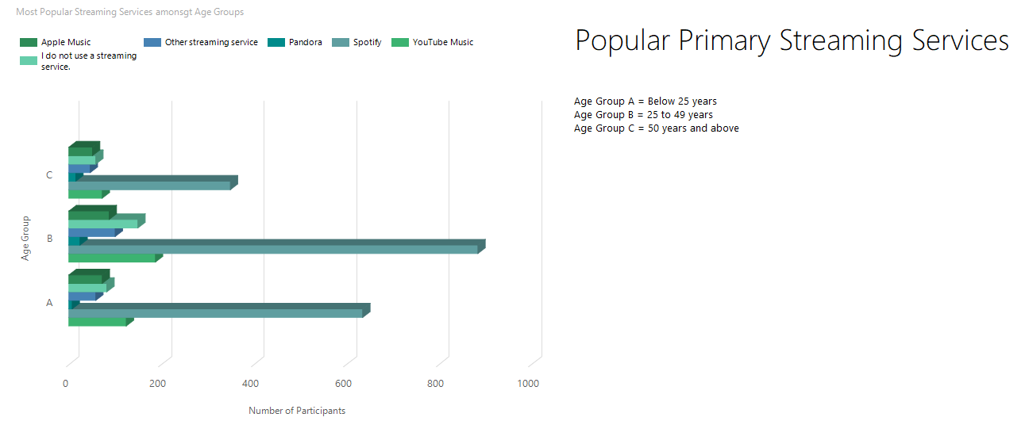
Primary Streaming Services by Age Groups

Slide 7
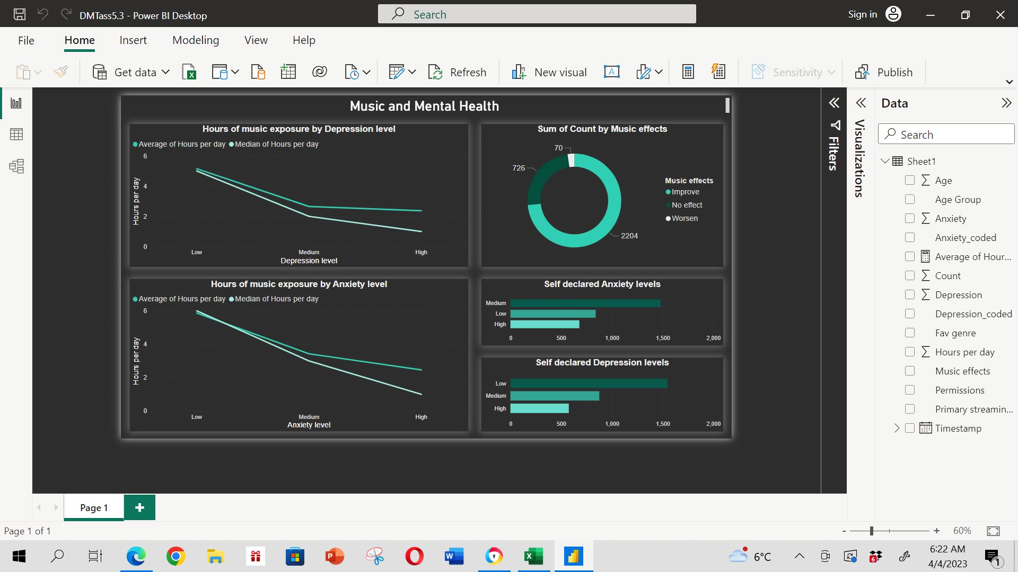
Music and Mental Health Correlation

Slide 8

Discussion on findings
The graphs and charts are created using Microsoft Power BI and Report builder
The visualizations have clearly and precisely resonated with the inquiries stated in Research questions
The third dashboard clearly establishes a positive correlation between music and better mental health.

Slide 9

Q/A
You are more than welcome to ask me questions!

Slide 10


Thank You!!
Presented by: Navid Saleh Sadik
Data source:
https://www.kaggle.com/datasets/catherinerasgaitis/mxmh-survey-results

